Slide 1
BFX-UA300 - K18X001.00
DOA Product No Boot FA Report
Prepare by: PE Long
Date : 2024.03.30

Slide 2
#1
Problem Description
Issue Description (5W2H)
When | 2024/Jan
Who | ALT customer
Where | SK networks warehouse, Anseong, Korea.
What | ALT customer feedback that they found out 1/316pcs has boot up fail.
Why | This issue follow SoC U1 (P/N: 002.03237.005LT, D/C:2112, Vendor: Synaptics) material has damage
How | Product no boot
How many | 1/316pcs ( F/R: 0.31%) as table below.
Serial number | SN | Issue | Production time | Detection time | Return time
A8934AFF3B24 | YYZ0YYF | Product no boot | 2023/Dec | 2024/Jan | 2024/Mar
Notes:
MA5800-X7#display cable modem <MAC> detail

Slide 3
#2
Establish the Team
Team Leader
Team Member
PE: Michael, Long
ME: Cheng Lun
PM: An Tran, Roisy
PD: Wen Yong
QA: Rachel
TE: Allan
IE: Hai Ly
Foxconn
  MFG Director: David Yin
  QA Manager : CB Lin, Toney

Slide 4
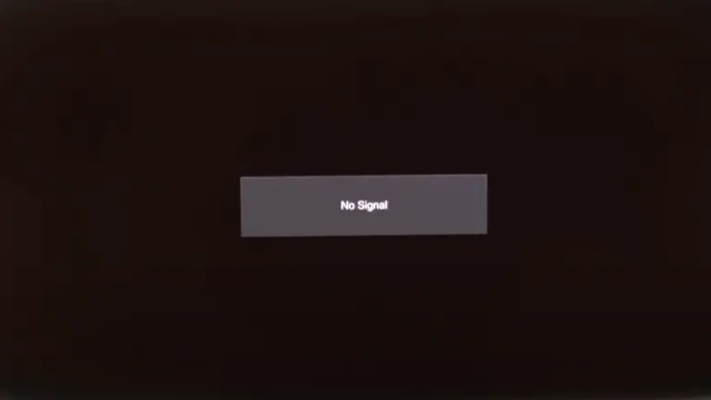
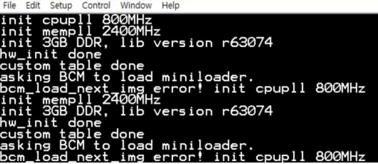
#3
Background Information
On 2024/Jan, K18X001.00 model, ALT customer feedback that they found out 1/316pcs has no boot.
Defect rate: 1/316 = 3164 DPPM → Return (2024/03) to Fii further analysis.
Fail symptom: Product no boot
Screen HDMI
Console Log
Summary:
- Product no boot
Notes:
5.26891E-07 4.96855E-07

Slide 5
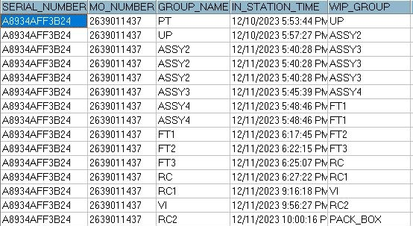
#4
System level
Recheck production data record.
Recheck test log FATP
No# | Station | Status
1 | BT | Pass
2 | PT | Pass
3 | UP | Pass
4 | FT1 | Pass
5 | FT2 | Pass
6 | FT3 | Pass
No# | Station | Status
7 | RC | Pass
8 | Power ON/OFF | Pass
9 | RC1 | Pass
10 | RC2 | Pass
Summary:
- Recheck production data record and test log ➔ Did not find out any abnormal.
Notes:
MA5800-X7#display cable modem <MAC> detail

Slide 6
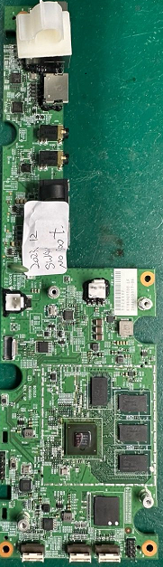
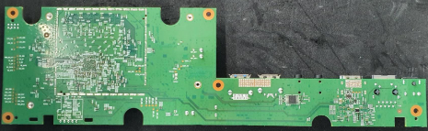
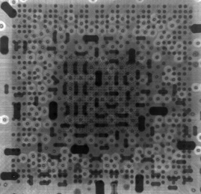
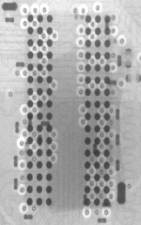
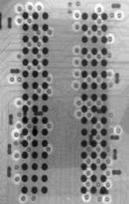
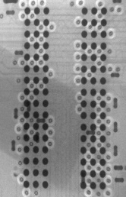
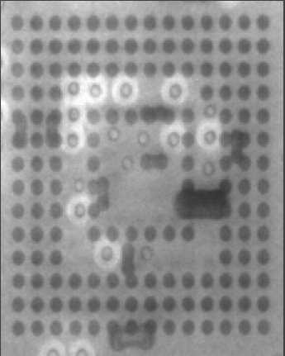
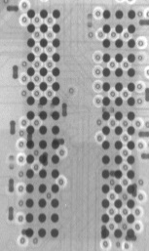
#5
Board level- 1:
Take visual inspection on top side, bottom side of NG board:
Top side sample
Bot side sample
Take X-ray at U1 ( SoC), DDR4(U2,U3,U4,U5), eMMC (U6) location:
X-ray SoC(U1)
X-ray DDR4
X-ray eMMC
Summary:
Don’t find out any abnormality at top/bottom side of NG boards.
Don’t find out process issue such as: Solder short ... on board
Notes:
5.26891E-07 4.96855E-07

Slide 7
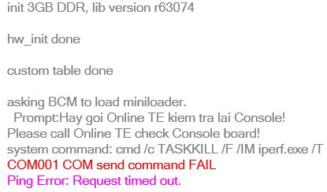
#6
Board level- 2:
Re-test at FATP
Retest NG board on FATP
Station | BT | PT | UP | FT1 | FT2 | FT3 | RC | RC1 | RC2
Status | Console run fail | No Ping
Result | Fail | Fail | Fail | Fail | Fail | Fail | Fail | Fail | Fail
BT test
Summary:
- Because product no boot- console run fail and no Ping so FATP can cover 100% this issue.
Notes:
5.26891E-07 4.96855E-07

Slide 8
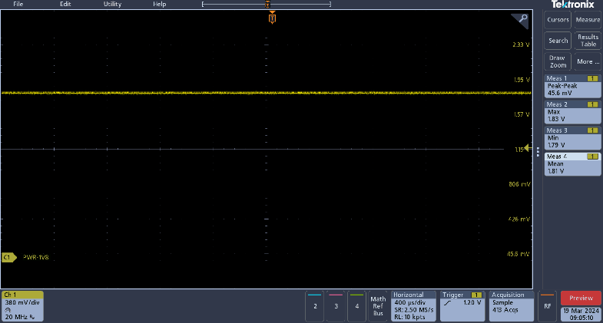
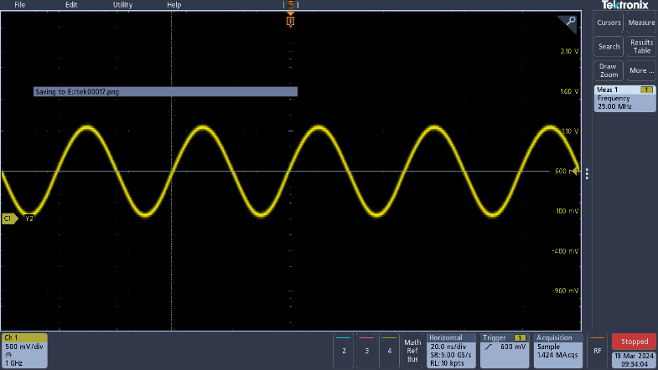
#7
Board level- 3:
Measure impedance ,voltage power and compare with OK sample as table bellow:
No. | Location | Description | Spec | NG sample |  | OK sample
 |  |  |  | Impedance Ohm | Voltage power V | Impedance Ohm | Voltage power V
1 | L817 | PWR_5V | 5 ±5% | 2.80K | 4.98 | 2.93K | 5.01
2 | R325 | PWR_DDR4_2V5 | 2.5 ±5% | 2.37K | 2.52 | 2.43K | 2.49
3 | R558 | PWR_VTT_0V6 | 0.6 ±5% | 2.841K | 0.6 | 2.77K | 0.6
4 | L822 | PWR_DDR4_1V2 | 1.2 ±5% | 70 | 1.19 | 76 | 1.22
5 | L815 | PWR_3V3 | 3.3 ±5% | 2.57K | 3.3 | 2.65K | 3.31
6 | L69 | PWR_CORE_1V05 | 1.05 ±5% | 140 | 1.08 | 158 | 1.09
7 | L816 | PWR_1V8 | 1.8 ±5% | 22 | 1.8 | 2.31K | 1.8
8 | L68 | PWR_CPU_1V05 | 1.05 ±5% | 426 | 1.13 | 479 | 1.12
PWR_1V8 – NG board
Crystal Y2 – NG board
Summary:
- All voltages of power suppliers are normal.
- Impedance at powers: PWR_1V8 are abnormal – short 22ohm with GND
Notes:
5.26891E-07 4.96855E-07

Slide 9
#8
Board level- 4 :
Remove IC chip use PWR_1V8 and measure impedance on board:
Step | Remove location | Measure PWR_1V8 | Result
1 | L816 | 22ohm | NG
2 | U1101 | 22ohm | NG
3 | L53 (U6 block) | 22ohm | NG
4 | U1318 | 22ohm | NG
5 | R805 (U801 block) | 22ohm | NG
6 | U1(SoC) | 2.9Kohm | OK
DC/DC
U1311
L816
U1101
U6
L53
PWR_1V8
U1318
U801
R805
U1
Summary:
- This issue follow SoC (P/N: 002.03237.005LT, D/C:2112, Vendor: Synaptics) material at U1 location .
Notes:
5.26891E-07 4.96855E-07

Slide 10
#9
Board level- 5 :
Changed new SoC and checking boot up status:
1. Measure impedance & power suppliers (focus on voltages 1.8V):
No. | Location | Description | NG sample |  | OK sample
 |  |  | Impedance Ohm | Voltage power V | Impedance Ohm | Voltage power V
1 | L816 | PWR_1V8 | 2.35K | 1.8 | 2.31K | 1.8
2. Check boot up status:
→ DOA boot up normal.
3. Do power on/off 10 times ( Power on: 10min, Off:30s) and received result as below:
No. | 1 | 2 | 3 | 4 | 5 | ……… | 10
Result | Pass | Pass | Pass | Pass | Pass |  | Pass
Summary:
After changing new SoC, The DOA boot up normally.

Slide 11
#10
Component level
Removed SoC and measure pin of NG SoC ( Focus 1V8 block), result as table below:
NO# | Pins | Description | Impedance
 |  |  | OK sample | NG sample
1 | M7 | AVDD_MEMPLL1P8 | 1.981M | 1.663M
2 | N7 | AVDD_CPUPLL1P8 | 1.783M | 1.687M
3 | AL10 | AVDD_HDMI1P8 | 3.111M | 3.106M
4 | AN10 | AVDD_HDMI1P8 | 3.130M | 3.109M
5 | AL16 | AVDD_AVPLL1P8 | 1.801M | 1.667M
6 | AN11 | AVDD_HDMI1P8 | 3.127M | 3.104M
7 | T30 | AVDD_EMMC1P8 | 3.544M | 3.521M
8 | U30 | AVDD_EMMC1P8 | 3.545M | 3.541M
9 | V30 | AVDD_PCIE1P8 | 0.934M | 23
10 | AB30 | AVDD_SATA1P8 | 0.931M | 147.7
11 | AF30 | AVDD_USB01_1P8 | 1.833M | 1.684M
12 | AH30 | AVDD_OSC1P8 | 1.314M | 43.6
13 | AM28 | AVDD_FE1P8 | 3.412M | 3.361M
14 | AN30 | AVDD_FE1P8 | 3.410M | 3.359M
15 | V32 | AVDD_PCIE1P8 | 0.940M | 23
16 | AD32 | AVDD_USB31P8 | 0.962M | 124
17 | AG32 | AVDD_USB01_1P8 | 1.833M | 1.711M
18 | AJ32 | AVDD_OSC1P8 | 1.330M | 43.6
19 | AK35 | AVHV_OTP1P8 | 1.5M | 1.475M
20 | AL32 | AVDD_LDO1P8 | 2.526M | 81.8
Summary: Measure impedance pins of NG SoC U1
➔ Find out Pins V30, AB30, AH30, V32, AD32, AJ32, AL32 abnormaly
Notes:
5.26891E-07 4.96855E-07

Slide 12
#11
Conclusion
Root cause:
- Occur cause: This issue follow SoC at U1 location (P/N: 002.03237.005LT, D/C:2112, Vendor: Synaptics) material has NG.
- Escape cause: FATP can cover 100% this issue.
Action:
- Recheck data on Y2023 produce q’ty 22018pcs
+ OBA tested 3435pcs ➔ Not find out the same issue.
+ Data repair on FATP ➔ Not find out the same issue.
➔ Low risk
- Send NG material to Synaptics vendor further analyze. Owner: SQE HaCao, vendor: Synaptics. Duedate: 03/27
Notes:
5.26891E-07 4.96855E-07

